Slide 1
Corporate Presentation
November 2022
EFT Trace ( Client Access)

Slide 2
Introduction
EFT Trace Functionality is now available in client user portal.
The function will enable the client in initiating EFT transaction trace request
The request will automatically trigger an email and sent to the ticketing system for Banking Services handling and monitoring.
Private & Confidential

Slide 3
Procedure
In Client access or Portal
1. Go to EFT menu – Transactions – Outgoing transactions
2. Select From and to date - Transaction list will appear
Private & Confidential

Slide 4
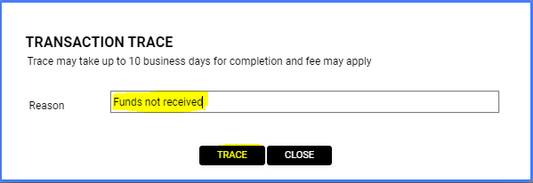
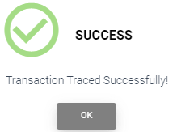
Procedure
3. In transaction list – select the EFT transaction for trace request by clicking the action trace button.
4. Pop up message will appear – indicate the trace request reason then hit ‘Trace’
5. Message will appear that the request is successful
6. An email will be generated and sent to ticketing system for banking services EFT trace handling.
Organization ID: 5000(Dcbank) to efttrace@dcbank.ca
Organization ID: 5000(Pateno) to efttrace@pateno.ca
Private & Confidential

Slide 5
Private & Confidential

